Slide 1
MINDFUL Planning: Deploying A ROBUST Electric Commander production system
Kathy Herring Hayashi
Senior Staff IT Engineer
Customer Use Case
Notes:
Continuous integration is the current best practice in software engineering – but ensuring the compute infrastructure is in step with the ideals of continuous integration (and delivery) are key.

Slide 2
Introduction
Kathy Herrring Hayashi
Senior Staff Engineer in IT
Former Senior Member of the Technical Staff at Cadence Design Systems and Unisys Corporation
Former Director at Syntricity for Professional Services and Support, providing internet based applications providing semiconductor yield reports
Instructor at Palomar College in Computer Science and Information Services
Avantika Mathur
Global Technical Account Manager and Senior Professional Services Engineer at Electric Cloud

Slide 3
Agenda
Business Requirements
Infrastructure Planning
Implementation
Aligning The Goals
Looking Forward

Slide 4
Business requirements
Solutions should be deployed at large scale compute farms located across the globe
Support diverse job types and extremely large compute volume
No downtimes should ever be expected
Integrate with aggressive schedules to meet competitive market demands
Adhere to stringent security requirements – security begins from within

Slide 5
Infrastructure ImpactS.
The first rule of any technology used in a business is that automation applied to an efficient operation will magnify the efficiency.
The second is that automation applied to an inefficient operation will magnify the inefficiency.
Bill Gates
Organizations want to react and make changes more rapidly
Continuous integrations and deployments allow projects to more quickly iterate and deploy
It’s not just about the automation. Consider the infrastructure to support the processes.
Notes:
Scale to meet the needs

Slide 6
Infrastructure considerations.
Are you highly available?
Does your system scale with customer needs?
Does your system provide the performance required?
Able to handle the diverse infrastructure needs of the applications?
Do you know when the system is not meeting these goals?
Keeping up with the needs of continuous integration without interruption. Any one of these will be a liability.
Notes:
Scale to meet the needs
Runtime predictability and Infrastructure errors are more easily seen with defined and repeatable continuous integration runs.
Scaleability, maintainabily, supportability, performance,

Slide 7
Planning.
If it’s up… | It’s down… per year
90% | 876 hours
95% | 438 hours
99% | 87 hours, 36 minutes
99.9% | 8 hours, 45 minutes, 36 seconds
99.99% | 52 minutes, 33.6 seconds
99.999% | 5 minutes, 15.36 seconds
99.9999% | 31.68 seconds
All downtimes should be scripted and minimally invasive
Use metrics to drive and understand calls to actions.
Reactions for all worst case scenarios need to be scripted and rehearsed
Well understood triggers for buying additional capacity, support, improvements and scaling
Clearly defined and responsive support channels
http://blog.monitor.us/2006/10/what-99-uptime-means/
Notes:
Planning is key. A lot of planning.
Roll back plan.

Slide 8
Electric cloud infrastructure
Implementing ElectricCommander in our environment, while considering business requirements and infrastructure impacts

Slide 9



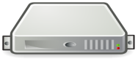
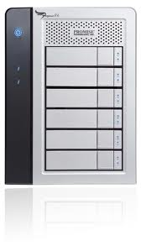
IMPLEMENTATION.
Custom Packaged Perl
API
Ectool & Ec-perl
Custom ENV for ec-perl environment
User on a web browser
Log Monitoring and Alerts
Red Hat
Clustering
SiteScope
Security Updates
Web Server
Software in Controlled Read Only Spaces
Database
ElectricCommander Server
Database
Oracle RAC
3 VIP Services
Disk Usage Quotas/Alerts
Workspaces
Agents
Scripted Upgrades/Deploy
Dev/Stage/Prod Environments
http://blog.monitor.us/2006/10/what-99-uptime-means/
Notes:
Planning is key. A lot of planning.
Roll back plan. Robust system. Things in place.

Slide 10
Implementation (cont’D)
User Environment
Dev/Stage/Prod Environments
CLI integration to call procedures with dynamic job steps
Dashboards created with GWT/Java SDK
IT Perspective
Log Monitoring (exported to external log tools)
Growth monitored to prepare for scale – proactive assessment of growth patterns

Slide 11
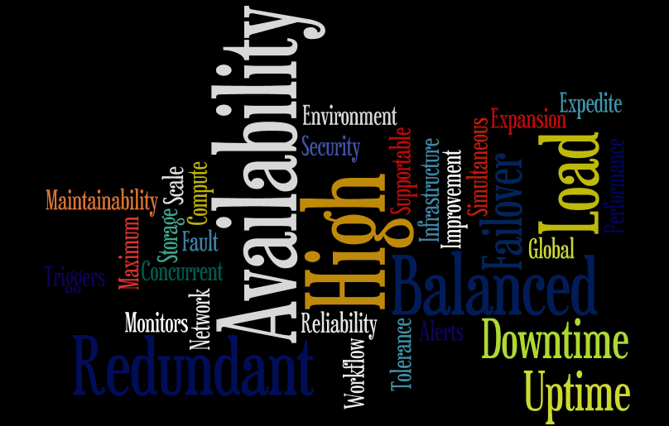
ENTERPRISE READY.
SCALING
Metrics used to scope job count in ec-agent servers to trigger additional agent buys.
Appropriately sized storage using disk forecasting and quotas. User quotas assist in creating well understood capacity needs for file system spaces.
PERFORMANCE
Load testing and performance testing for expected job volumes and property usage
Performant database using Oracle RAC
High Availability
Alerts to trigger when sites are unavailable or failed over
Servers tested for seamless fail over scenarios
Notes:
If alerts have gone on that the maximum capacity has been reached, it is too late to add capacity that will take weeks to expedite into the system.
Due to the lead time to receive additional capacity, the system must have a plan to scale to avoid unnecessary interruptions within the system.
Either approval, cost or purchase – takes time.

Slide 12
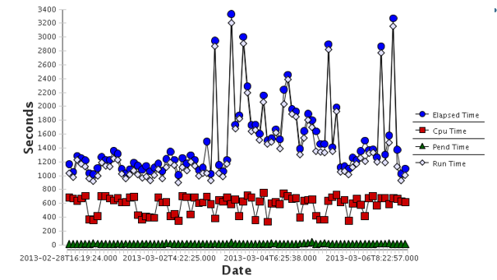
METRIC DRIVEN APPROACH.
Metrics are key to not only scaling and monitoring the system, but vital in any systems debug.
When an concern is raised, the first question should be “where are the metrics?”
Used to understand the scope and analysis of any issue, then verify that issues have been resolved.
Correctly used, metrics convert data to information.
Job Metrics from scheduled jobs in Electric Commander

Slide 13
Aligning the goals
new ElectricCommander features are in line with these requirements and goals, and support deployment of a robust and enterprise ready production system.
Avantika Mathur, Professional Services Engineer
Electric Cloud

Slide 14


Aligning the Goals
High Availability
ElectricCommander 5.0 now inherently supports an active-active cluster of one or more servers
Zero downtime if one server goes down
Requests are automatically re-routed to the running Commander server(s)
Horizontal Scalability
A multiple server cluster supports an increased number of simultaneous jobs and API requests.
Requests are distributed across the multiple servers
Better performance with high load volumes
Plan ahead and expand capacity as required over time by adding additional Commander servers
Avantika Mathur, Professional Services Engineer
Electric Cloud

Slide 15
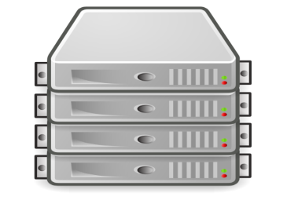
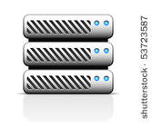
Clustering Architecture
Load Balancer
User on a web browser
Database
Web Server
ZooKeeper
(odd number of instances with shared information)
Agent results sent to load balancer for routing back to ElectricCommander cluster
ElectricCommander Server in Cluster
Filers
Agents
Avantika Mathur, Professional Services Engineer
Electric Cloud
Notes:
Redundancy
Scalability
HA
- How we have improved the syste

Slide 16

Aligning the Goals
Reduced downtime
The new background upgrade tool performs the database schema upgrade while the server is running
minimize downtime necessary to perform the upgrade.
Metrics
A new integration with StatsD and Graphite provide ability to gather and track various metrics on the Commander server
Avantika Mathur, Professional Services Engineer
Electric Cloud

Slide 17
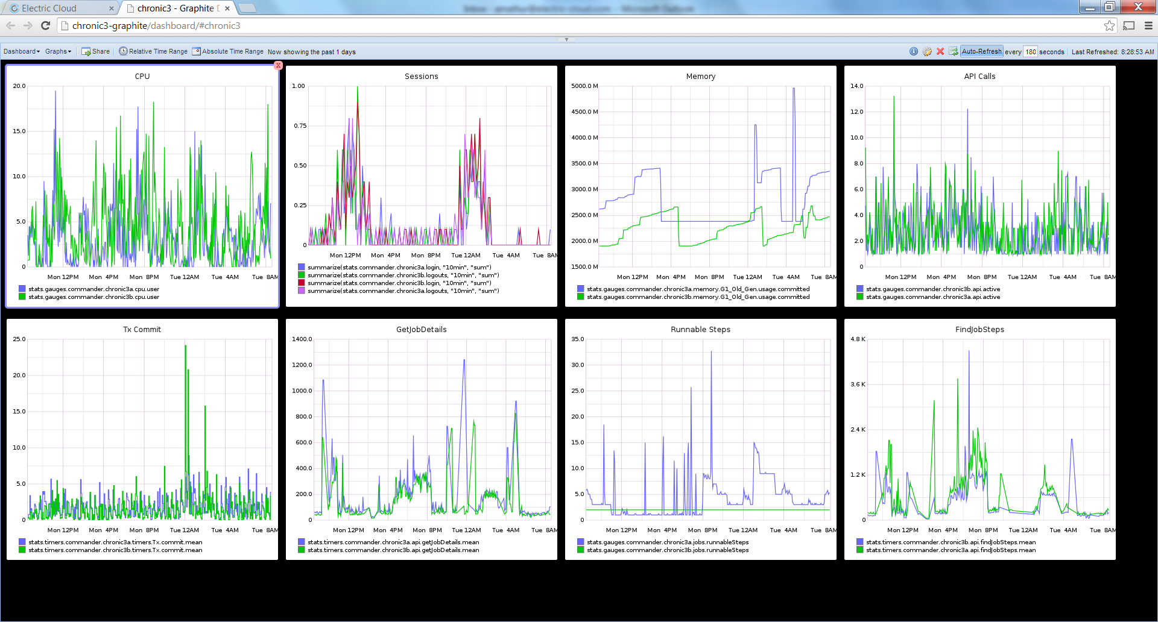
ElectricCommander Metrics
Avantika Mathur, Professional Services Engineer
Electric Cloud

Slide 18
Continuous Improvements.
Increased focus on security – updates which include timely critical security patches
Focus on global implementation with workforce spread across the globe
Continued focus on performance improvements for large scale usage
Additional configuration hooks for custom installations

Slide 19
Continuous Improvements.
Taking control of your entire software development process.
Things that went well?
What have we learned?
How can we do it better?
What do we not know.
Continuing to meet the infrastructure needs of the workflows we support.

Slide 20
Discussion

